Slide 1


Linear Regression
Hossam Ahmed Salah
MSP Helwan

Slide 2



Agenda
House pricing problem
What is a Linear Model ?
Linear regression univariate and multivariate
MAE and MSE
Gradient descent
Batch gradient descent Vs stochastic gradient descent
Code

Slide 3

House pricing problem

Slide 4
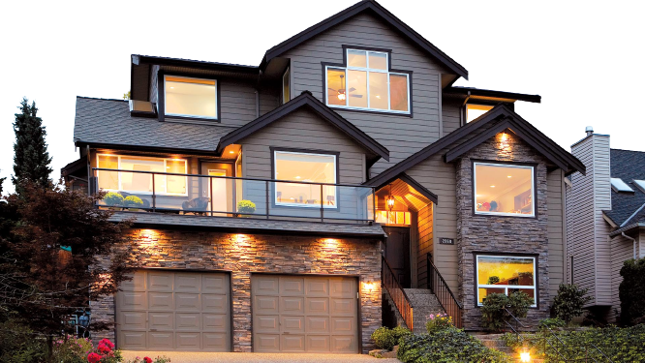

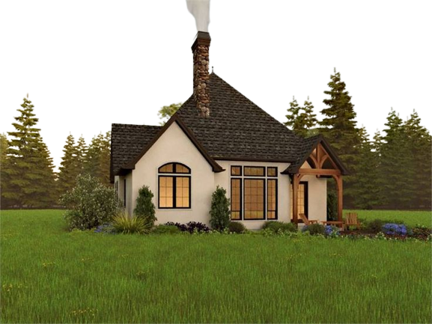

Slide 5


Slide 6


Slide 7


Slide 8


Slide 9













Slide 11

What is a Linear Model ?

Slide 12


What is the Line ?

Slide 13


Slide 16

So, a line can move UP/DOWN , Right/Left or a mix of the two
Mathematically a line is
$$f\left(x\right)=mx+b$$
m : slope represent how much you want to turn the line (circular move 🕓)
b : the intercept of Y (⬆️ ⬇️ control)

Slide 17

We have features of some object like the house for example : {size, location, number of rooms, price, …}
The model is simply a function represent the relation between the target feature and the rest of the features
$$F\left(Features\right)=Target$$
$$F\left(size,num of rooms,location,…\right)=price$$

Slide 18

Linear regression univariate and multivariate

Slide 19
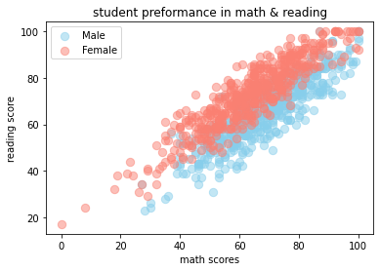


Slide 20
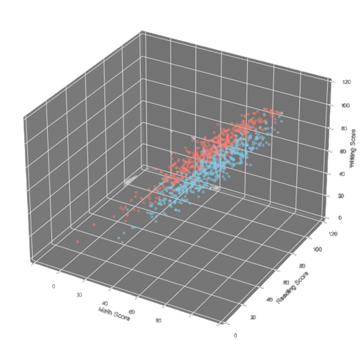

































Slide 21
Mean Absolute Error (MAE) and Mean Squared Error (MSE)

Slide 23


Slide 24
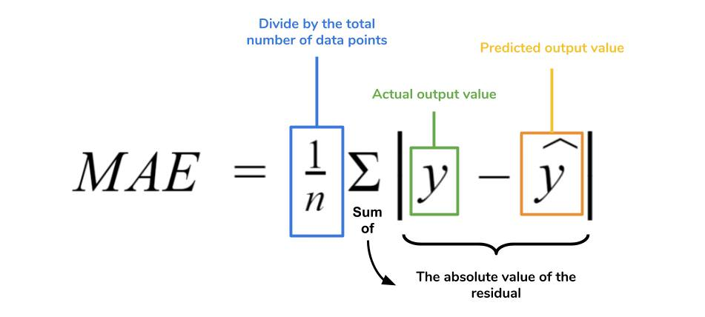


Slide 26

$$MSE=\frac{1}{m}\sum{{\left(y−\hat{y}\right)}^{2}}$$

Slide 27

Gradient descent

Slide 28
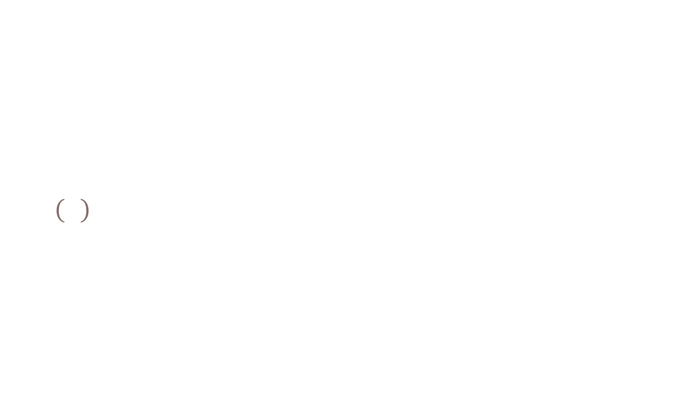
We have a model that generate error when trying to predict the target
We want to minimize the error that the model generate
The model have only two changeable parameters we would call them weights
The two are the slope and the intercept
$f\left(x\right)=w_{1}x+w_{2}$
So, we need to find the optimal weights the optimal value we can pick for the slope and the optimal for the intercept
Optimal mean it generate less error MAE or MSE
Our task is to minimize the Error MSE for example we would use partial derivative

Slide 29














Slide 30














Slide 31
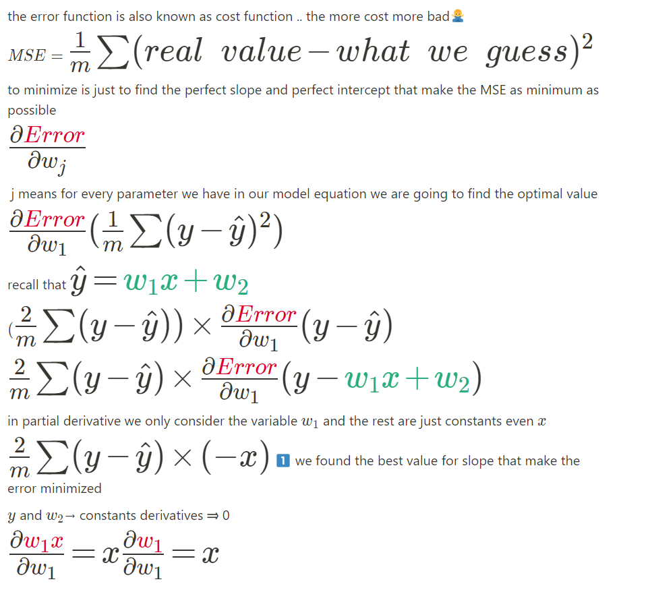

Slide 32
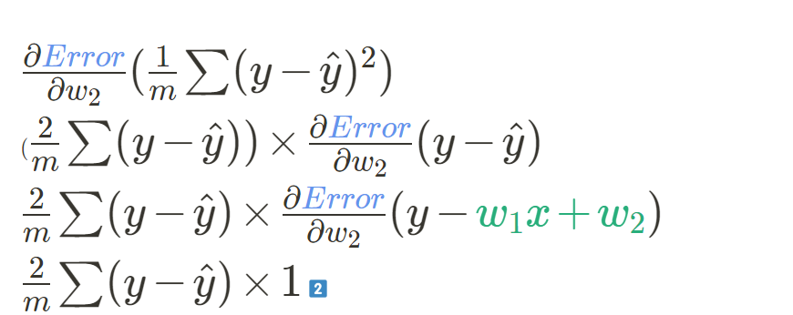

Slide 33
Batch Gradient Descent VS Stochastic Gradient Descent
Batch gradient descent: Calculate optimal values for all points, sum them, and update the weights accordingly.
Stochastic gradient descent: Calculate the optimal values for one point at a time, update the weights, and move on to the next point.

Slide 34
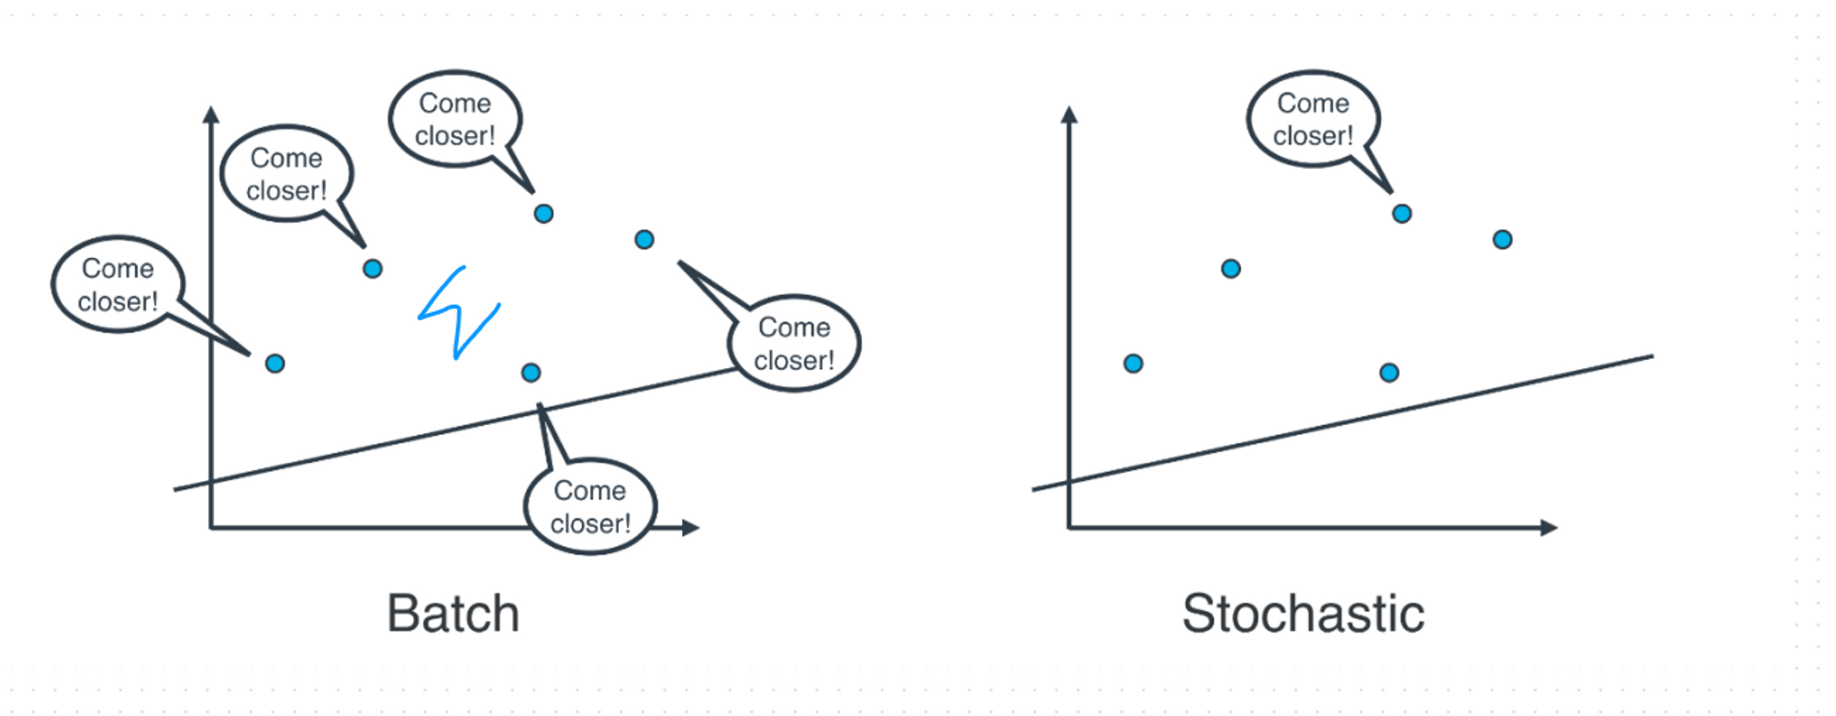

Slide 35

The question is, which one is used in practice?
In most cases, neither.
Think about this: If your data is huge, both are a bit slow, computationally. The best way to do linear regression, is to split your data into many small batches. Each batch, with roughly the same number of points. Then, use each batch to update your weights. This is still called mini-batch gradient descent.

Slide 36

Thank you
Time for code now

